Slide 1
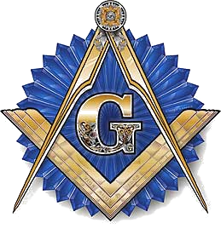
Forging Partnerships High Twelve and Masonic Blue Lodges “A Call From Labor to Refreshment”
High Twelve International

Slide 2
What is High Twelve?
An association of Master Masons
Men who desire to gather in Masonic fellowship independent of the formal Ritual of Lodge
But
Masons dedicated to the service of the fraternity,
our country and our youth!
Bottom Line:
Masonry In Action!

Slide 3
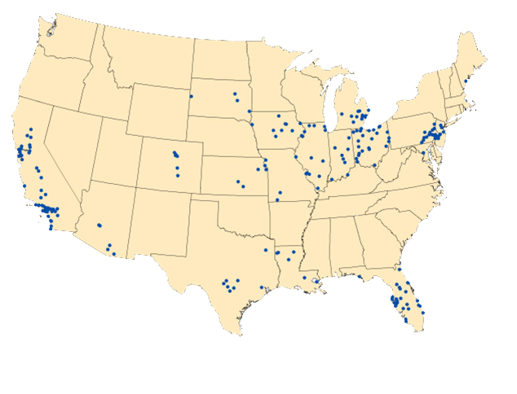
High Twelve International Members
5,000 Plus Master Masons
170 Plus Clubs
15 State Associations
7 Independent Clubs
2 International Countries

Slide 4
High Twelve Clubs are chartered in the United States where the Grand Jurisdictions permit such concordant organizations
The local Clubs
are the foundation upon which the
State Associations are built
and
High Twelve International
are built upon the State Associations

Slide 5
In Service To Freemasonry
High Twelve affords valuable assistance to the Blue Lodges in whatever manners judged most needed.
High Twelve is “MASONRY IN ACTION”
In the communities where each Club holds its meetings, and
2. In the States where the several clubs are banded together in a common purpose.
High Twelvians adhere strictly to
Masonic Law of that jurisdiction.

Slide 6
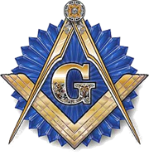
Forging Partnerships High Twelve and Masonic Lodges
High Twelve Clubs offer special opportunities
For Masons and their ladies
So they can continue to enjoy a Masonic experience without ritual
or
Have a desire to participate in the Service Club experience!
Notes:
Offer special opportunities for

Slide 7
Support Good Government
How?
Through the Wolcott Foundation
High Twelve’s Major Service Activity
Providing Fellowships at George Washington University
Master Degrees in Federal Government ***** and Foreign Service

Slide 8
Support Good Schools
How?
Providing Scholarships
School Recognition Nights

Slide 9
Support Youth
How?
Emphasizing Masonic Youth Groups
Recognition and Support of Outstanding Community Youth

Slide 10
History of High Twelve
Initial Club was started by E.C. “Wallie” Wolcott in Sioux City, Iowa in 1921
Oakland, California was the second Club followed by clubs in Berkley, Santa Rosa, Fresno, Salinas, San Jose, Santa Barbara and Stockton

Slide 11
High Twelve Emblem
Clock: proclaims the Hour of High Twelve
Three Ascending Steps: Symbolize the three degrees of Masonry
Motto “To Talk Little” – “To Hear Much” – “To Reflect Upon Truth”: Can be traced to the Masonic Lodges of London in the 1700s
Designed by L.W. Howe, Sioux City Club

Slide 12
An Invitation To You
An open invitation is extended to all Master Masons to visit a High Twelve Club, whether he is a local Masonic Brother or a Sojourner.
“If you visit my Club, I will buy your meal!”

Slide 13
Prepared by: High Twelve International Copyright 2013
Forging Partnerships High Twelve and Masonic Blue Lodges

